Slide 1
Unit 2
A Raisin in the Sun

Slide 2
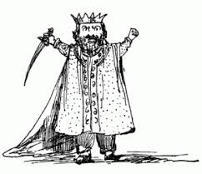
1.Tyrant
A cruel ruler

Slide 3
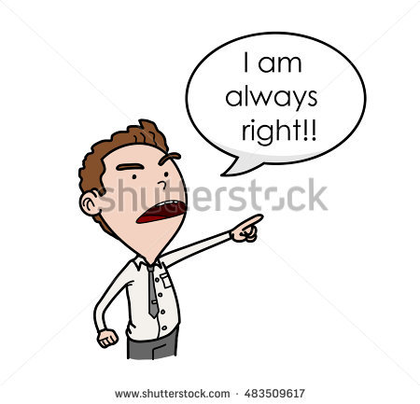
2. Arrogant
Conceited

Slide 4
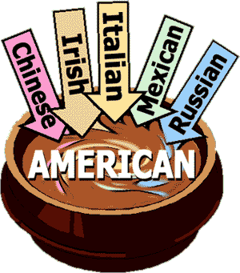
3. Assimilate
To get used to and become part of the culture or place

Slide 5

4. Bitter
Angry or bitter because of disappointment in life

Slide 6

5. Ethical
Morally right

Slide 7
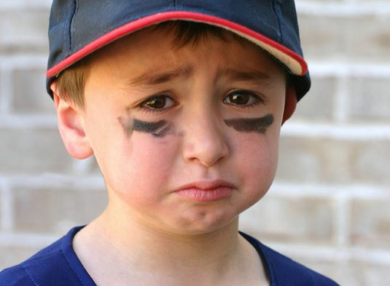
6. Sullen
Gloomy or bad tempered

Slide 8
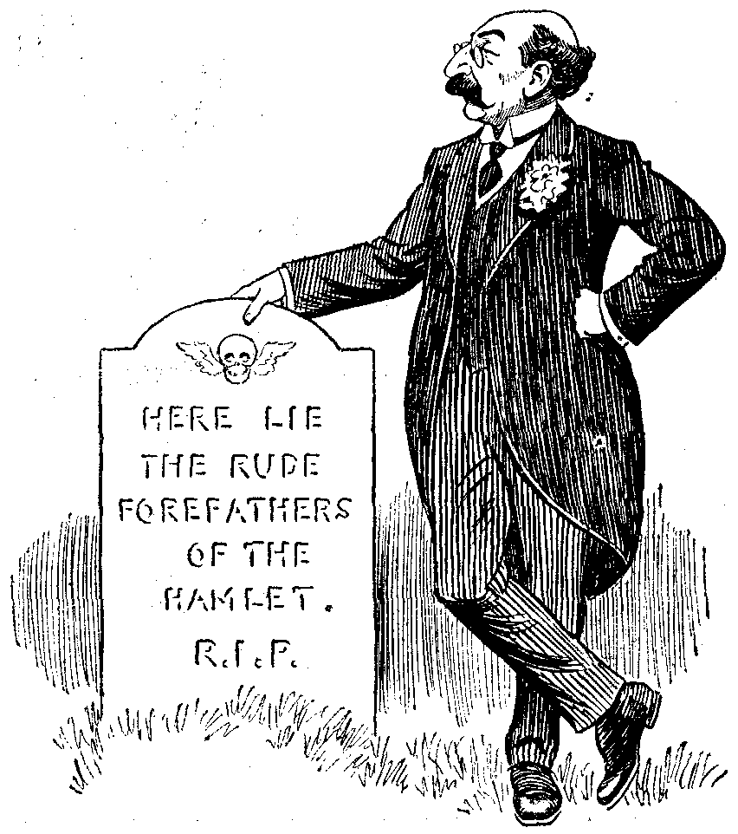
7. Elegy
Formal writing about death

Slide 9
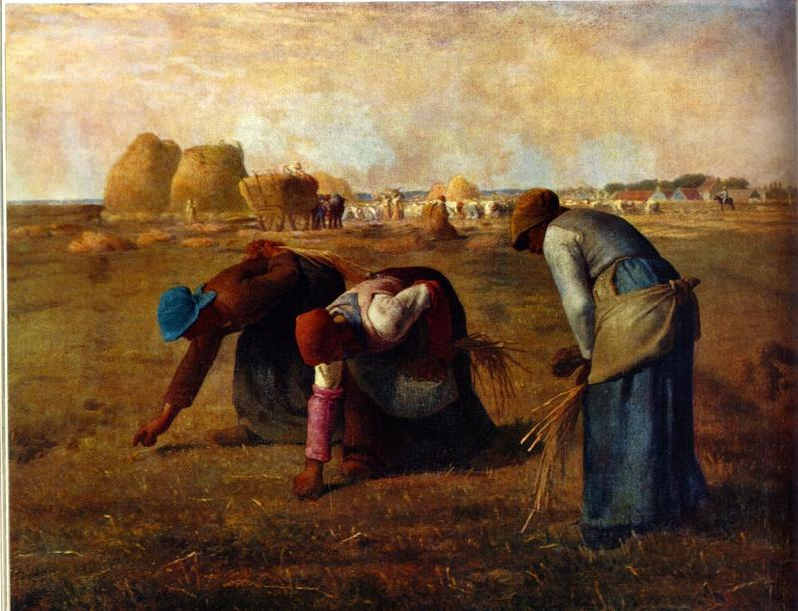
8. Realism
Showing the world as it really is

